Slide 1
Mechanisms and Robotics Laboratory Exercises - Day 4

Slide 2
Contents
Exercises Day - 4
Inverse Kinematics of a 2dof Planar Robot using matrix inverse
Inverse Kinematics of a 4dof SCARA robot
Inverse Kinematics of a 3 dof Articulated Robot using matrix inverse
Notes:
References:
https://opentextbc.ca/teachinginadigitalage/chapter/section-8-1-a-short-history-of-educational-technology/?utm_source=timminstoday.com&utm_campaign=timminstoday.com&utm_medium=referral
https://www.riemysore.ac.in/ict/unit__7__elearning.html#7.5
https://www.youtube.com/watch?v=jTH3ob1IRFo
Skinner, B. (1968) The Technology of Teaching, 1968. New York: Appleton-Century-Crofts

Slide 3
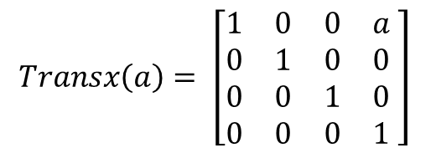
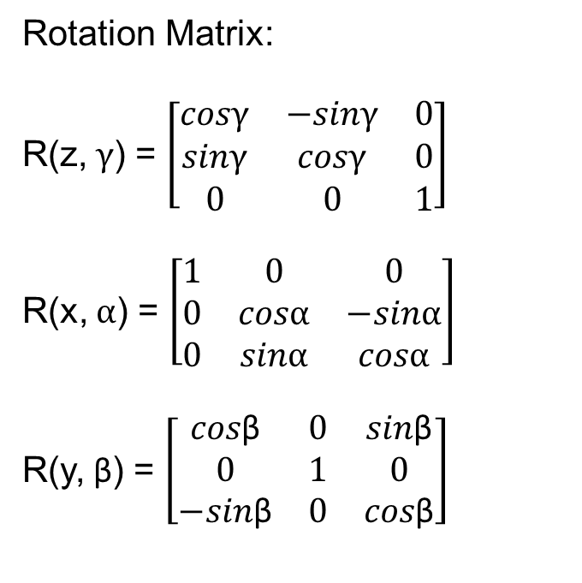
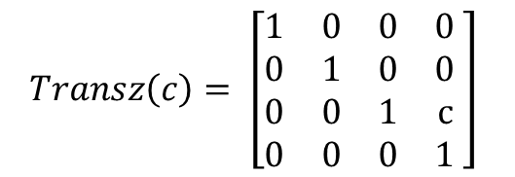
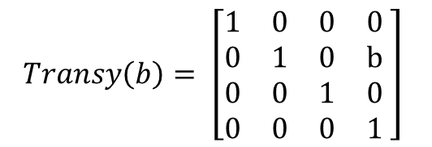
Solution
Rotation Matrix:
R(z, $γ$) = $\left[\begin{matrix}cosγ & −sinγ & 0 \\ sinγ & cosγ & 0 \\ 0 & 0 & 1\end{matrix}\right]$
R(x, $α$) = $\left[\begin{matrix}1 & 0 & 0 \\ 0 & cosα & −sinα \\ 0 & sinα & cosα\end{matrix}\right]$
R(y, β) = $\left[\begin{matrix}cos\text{β} & 0 & sin\text{β} \\ 0 & 1 & 0 \\ −sin\text{β} & 0 & cos\text{β}\end{matrix}\right]$
$$Transx\left(a\right)= \left[\begin{matrix}1 & 0 & 0 & a \\ 0 & 1 & 0 & 0 \\ 0 & 0 & 1 & 0 \\ 0 & 0 & 0 & 1\end{matrix} \right]$$
$$Transy\left(b\right)= \left[\begin{matrix}1 & 0 & 0 & 0 \\ 0 & 1 & 0 & b \\ 0 & 0 & 1 & 0 \\ 0 & 0 & 0 & 1\end{matrix} \right]$$
$$Transz\left(c\right)= \left[\begin{matrix}1 & 0 & 0 & 0 \\ 0 & 1 & 0 & 0 \\ 0 & 0 & 1 & c \\ 0 & 0 & 0 & 1\end{matrix} \right]$$

Slide 4
Inverse Kinematics of a SCARA Arm

Slide 5
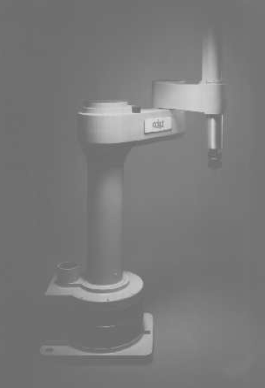
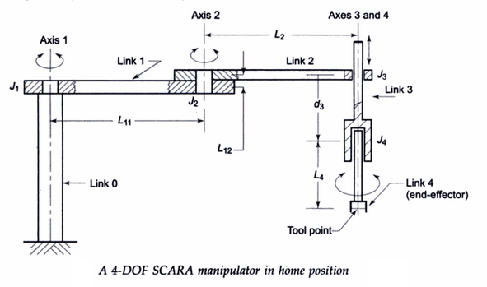

Slide 6
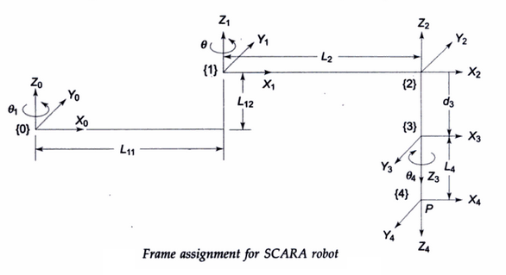

Slide 7
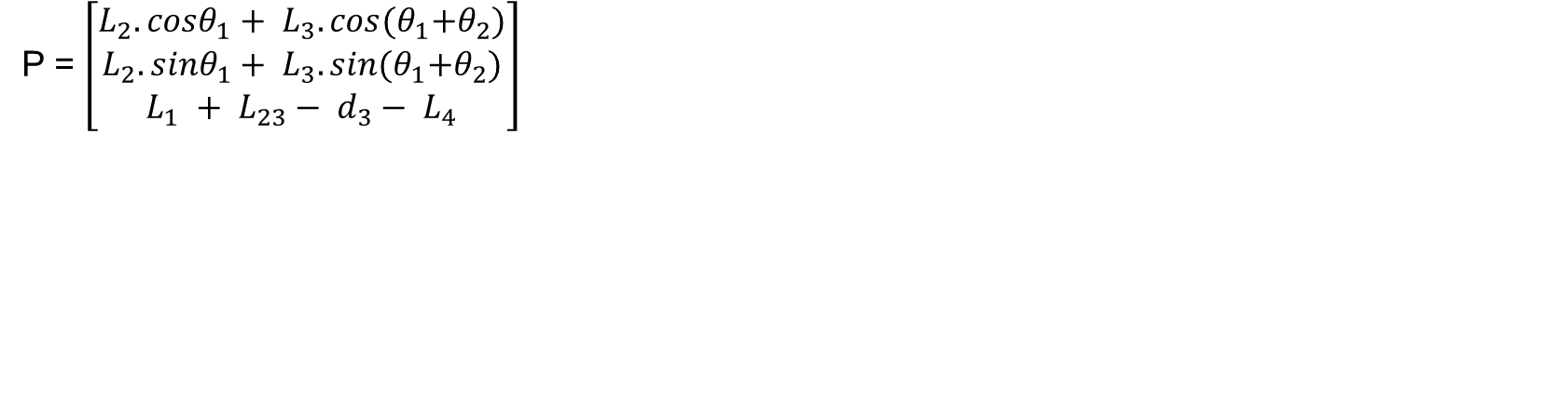
P = $\left[\begin{matrix}L_{2}.cosθ_{1}+ L_{3}.cos{(θ}_{1}+θ_{2}) \\ L_{2}. sinθ_{1}+ L_{3}. sin{(θ}_{1}+θ_{2}) \\ L_{1} + L_{23}− d_{3}− L_{4}\end{matrix}\right]$

Slide 8
Inverse Kinematics of a Planar Arm

Slide 9
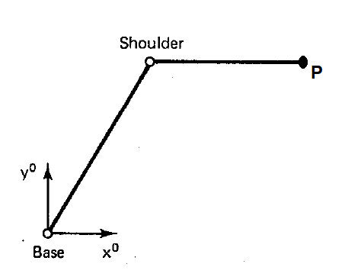
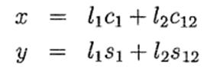
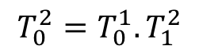
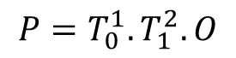
P (700, 400)
L1 = 500 mm
L2 = 400 mm
$${P=T}_{0}^{1}. T_{1}^{2}.O$$
$${T_{0}^{2}=T}_{0}^{1}. T_{1}^{2}$$

Slide 10
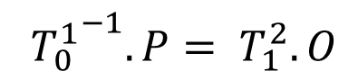
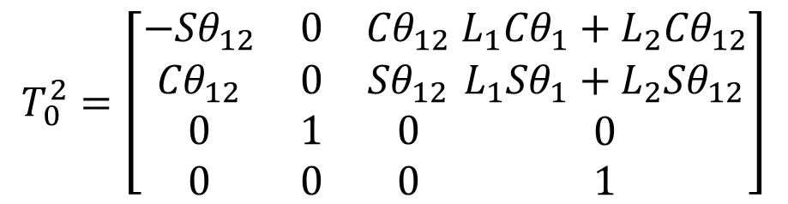
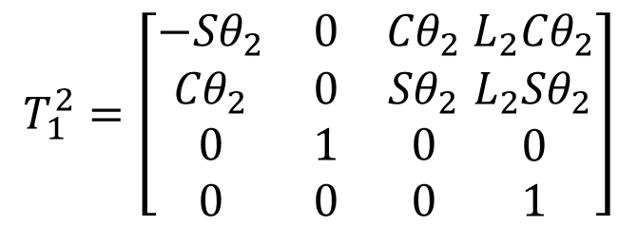
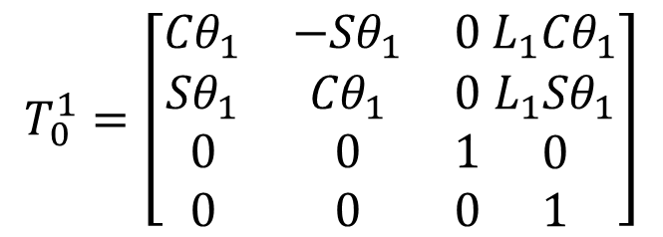
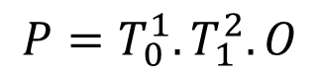
$$T_{0}^{2}=\left[\begin{matrix}{−Sθ}_{12} & 0 & {Cθ}_{12} \\ {Cθ}_{12} & 0 & {Sθ}_{12} \\ \begin{matrix}0 \\ 0\end{matrix} & \begin{matrix}1 \\ 0\end{matrix} & \begin{matrix}0 \\ 0\end{matrix}\end{matrix} \begin{matrix}{{{L_{1}Cθ}_{1}+L}_{2}Cθ}_{12} \\ {{{L_{1}Sθ}_{1}+L}_{2}Sθ}_{12} \\ \begin{matrix}0 \\ 1\end{matrix}\end{matrix}\right]$$
$${P=T}_{0}^{1}. T_{1}^{2}.O$$
$${T_{0}^{1}}^{−1}.P= T_{1}^{2}.O$$
$$T_{1}^{2}=\left[\begin{matrix}{−Sθ}_{2} & 0 & {Cθ}_{2} \\ {Cθ}_{2} & 0 & {Sθ}_{2} \\ \begin{matrix}0 \\ 0\end{matrix} & \begin{matrix}1 \\ 0\end{matrix} & \begin{matrix}0 \\ 0\end{matrix}\end{matrix} \begin{matrix}{L_{2}Cθ}_{2} \\ {L_{2}Sθ}_{2} \\ \begin{matrix}0 \\ 1\end{matrix}\end{matrix}\right]$$
$$T_{0}^{1}=\left[\begin{matrix}{Cθ}_{1} & {−Sθ}_{1} & 0 \\ {Sθ}_{1} & {Cθ}_{1} & 0 \\ \begin{matrix}0 \\ 0\end{matrix} & \begin{matrix}0 \\ 0\end{matrix} & \begin{matrix}1 \\ 0\end{matrix}\end{matrix} \begin{matrix}{L_{1}Cθ}_{1} \\ {L_{1}Sθ}_{1} \\ \begin{matrix}0 \\ 1\end{matrix}\end{matrix}\right]$$

Slide 11
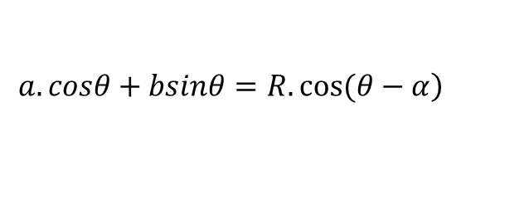
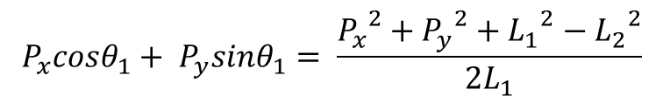
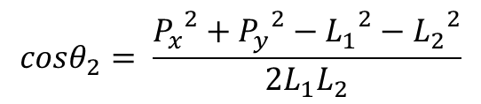
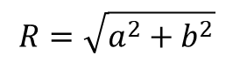
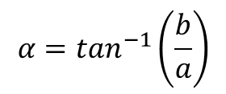
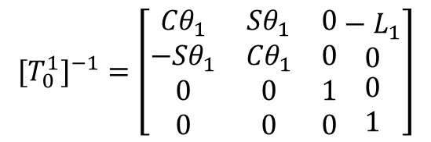
$${{[T}_{0}^{1}]}^{−1}=\left[\begin{matrix}{Cθ}_{1} & {Sθ}_{1} & 0 \\ {−Sθ}_{1} & {Cθ}_{1} & 0 \\ \begin{matrix}0 \\ 0\end{matrix} & \begin{matrix}0 \\ 0\end{matrix} & \begin{matrix}1 \\ 0\end{matrix}\end{matrix} \begin{matrix}− L_{1} \\ 0 \\ \begin{matrix}0 \\ 1\end{matrix}\end{matrix}\right]$$
$$\left.a.cosθ+bsinθ=R.cos⁡(θ−α\right)$$
$$α=\tan^{−1}\left(\frac{b}{a}\right)$$
$$R=\sqrt{a^{2}+b^{2}}$$
$$cosθ_{2}= \frac{{P_{x}}^{2}+{P_{y}}^{2}−{L_{1}}^{2}−{L_{2}}^{2}}{2L_{1}L_{2}}$$
$$P_{x}cosθ_{1}+ P_{y}sinθ_{1}= \frac{{P_{x}}^{2}+{P_{y}}^{2}+{L_{1}}^{2}−{L_{2}}^{2}}{2L_{1}}$$

Slide 12
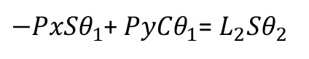
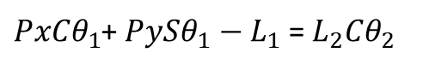
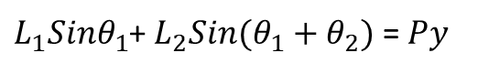
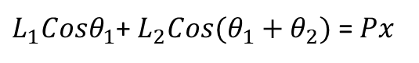
${L_{1}Cosθ}_{1}$+ ${L_{2}Cos(θ_{1}+θ}_{2})$ = $Px$
Coupled Equations
${L_{1}Sinθ}_{1}$+ ${L_{2}Sin(θ_{1}+θ}_{2})$ = $Py$
${PxCθ}_{1}$+ $Py{Sθ}_{1}−L_{1}$ = ${L_{2}Cθ}_{2}$
Decoupled Equations
${−PxSθ}_{1}$+ ${PyCθ}_{1}$= ${L_{2}Sθ}_{2}$

Slide 13
Inverse Kinematics of a 3 dof Articulated Arm

Slide 14
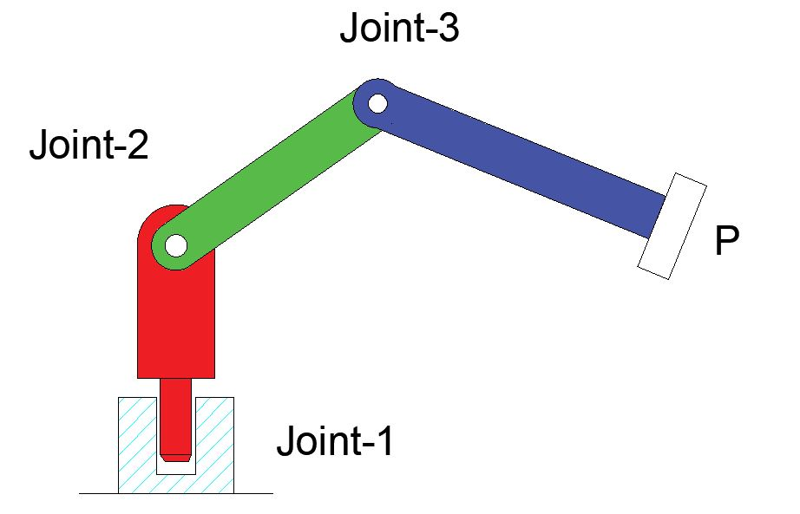
3 dof Articulated manipulator
Problem No. 6
Develop workspace points in MATLAB for articulated manipulator whose joint angles are π, π/2 and π/2, link lengths L1 = 100mm, L₂=L₃=300 mm.

Slide 15
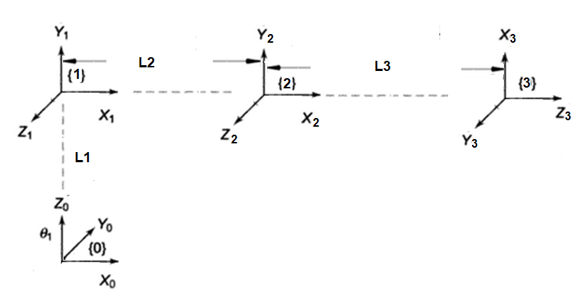
Link i | θ | d | α | a | Home
1 | θ1 | L1 | 90
2 | θ2 |  |  | L2
3 | θ3 |  | 90 | L3 | 90

Slide 16
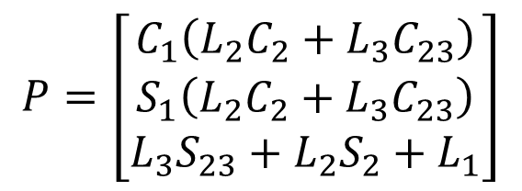
Solution
P = [rotz(θ1)*transz(L1)*rotx(90)]*[rotz(θ2)*transx(L2)]*[rotz(θ3)*transx(L3)*rotz(90)rotx(90)]*origin
$T_{0}^{1}$ = [rotz(θ1)*transz(L1)*rotx(90)]
$T_{1}^{2}$ = [rotz(θ2)*transx(L2)]
$T_{2}^{3}$ = [rotz(θ3)*transx(L3)*rotz(90)rotx(90)]
Link i | θ | d | α | a | Home
1 | θ1 | L1 | 90
2 | θ2 |  |  | L2
3 | θ3 |  | 90 | L3 | 90
$$P=\left[\begin{matrix}C_{1}\left(L_{2}C_{2}+L_{3}C_{23}\right) \\ S_{1}\left(L_{2}C_{2}+L_{3}C_{23}\right) \\ L_{3}S_{23}+L_{2}S_{2}+L_{1}\end{matrix}\right]$$

Slide 17
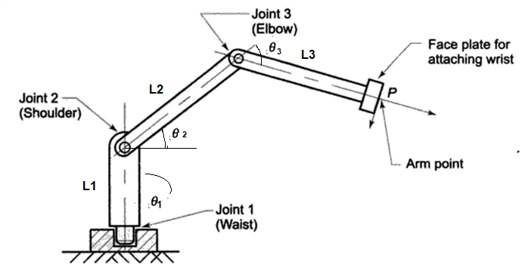
Home Work – Inverse Kinematics of a 3 dof arm using matrix inverse
Find the angles for the given tool point
P (650, 200, 250)
L1 = 150 mm
L2 = 400 mm
L3 = 300 mm

Slide 18
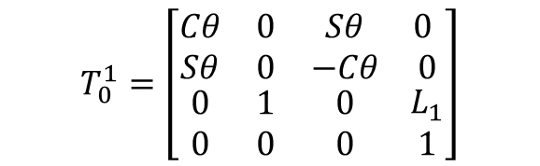
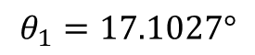
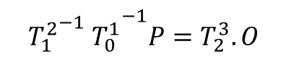
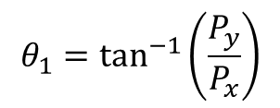
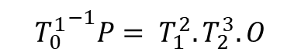
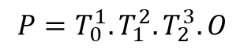
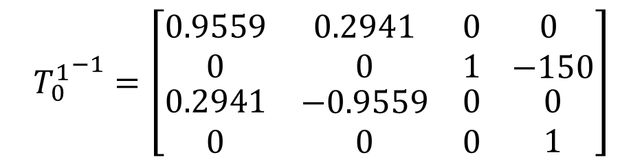
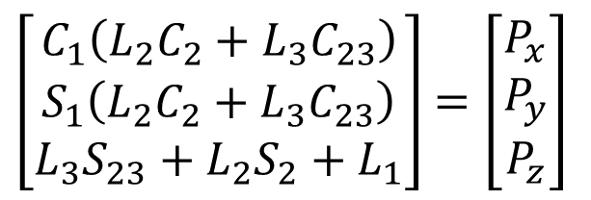
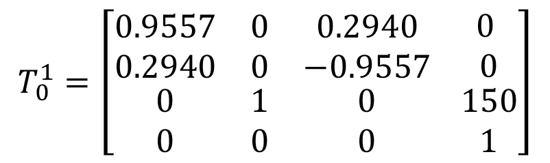
Home Work – Inverse Kinematics of a 3 dof arm using matrix inverse
Solution from Forward Kinematics
$${P=T}_{0}^{1}. T_{1}^{2}.T_{2}^{3}.O$$
$${T_{0}^{1}}^{−1}P= T_{1}^{2}.T_{2}^{3}.O$$
$\left[\begin{matrix}C_{1}\left(L_{2}C_{2}+L_{3}C_{23}\right) \\ S_{1}\left(L_{2}C_{2}+L_{3}C_{23}\right) \\ L_{3}S_{23}+L_{2}S_{2}+L_{1}\end{matrix}\right]$ $=\left[\begin{matrix}P_{x} \\ P_{y} \\ P_{z}\end{matrix}\right]$
$${{{{ T}_{1}^{2}}^{−1} T}_{0}^{1}}^{−1}P=T_{2}^{3}.O$$
$$T_{0}^{1}=\left[\begin{matrix}Cθ & 0 & Sθ \\ Sθ & 0 & −Cθ \\ \begin{matrix}0 \\ 0\end{matrix} & \begin{matrix}1 \\ 0\end{matrix} & \begin{matrix}0 \\ 0\end{matrix}\end{matrix} \begin{matrix} 0 \\ 0 \\ \begin{matrix}L_{1} \\ 1\end{matrix}\end{matrix}\right]$$
$$T_{0}^{1}=\left[\begin{matrix}0.9557 & 0 & 0.2940 \\ 0.2940 & 0 & −0.9557 \\ \begin{matrix}0 \\ 0\end{matrix} & \begin{matrix}1 \\ 0\end{matrix} & \begin{matrix}0 \\ 0\end{matrix}\end{matrix} \begin{matrix} 0 \\ 0 \\ \begin{matrix}150 \\ 1\end{matrix}\end{matrix}\right]$$
$$θ_{1}=\tan^{−1}\left(\frac{P_{y}}{P_{x}}\right)$$
$$θ_{1}=17.1027°$$
$${T_{0}^{1}}^{−1}=\left[\begin{matrix}0.9559 & 0.2941 & 0 \\ 0 & 0 & 1 \\ \begin{matrix}0.2941 \\ 0\end{matrix} & \begin{matrix}−0.9559 \\ 0\end{matrix} & \begin{matrix}0 \\ 0\end{matrix}\end{matrix} \begin{matrix} 0 \\ −150 \\ \begin{matrix}0 \\ 1\end{matrix}\end{matrix}\right]$$

Slide 19
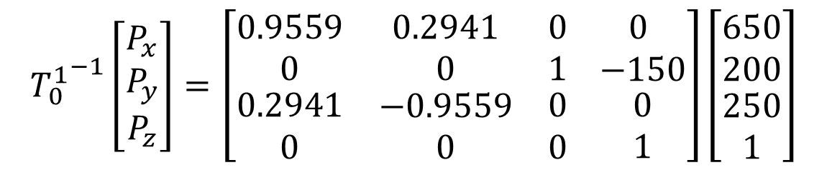


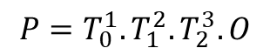
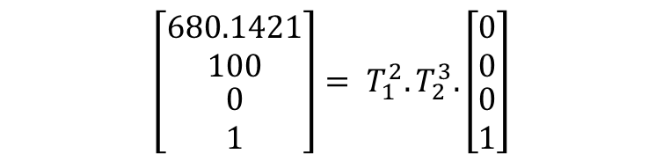
Home Work – Inverse Kinematics of a 3 dof arm using matrix inverse
Solution from Forward Kinematics
$${P=T}_{0}^{1}. T_{1}^{2}.T_{2}^{3}.O$$
$${T_{0}^{1}}^{−1}P= T_{1}^{2}.T_{2}^{3}.O$$
$\left[\begin{matrix}C_{1}\left(L_{2}C_{2}+L_{3}C_{23}\right) \\ S_{1}\left(L_{2}C_{2}+L_{3}C_{23}\right) \\ L_{3}S_{23}+L_{2}S_{2}+L_{1}\end{matrix}\right]$ $=\left[\begin{matrix}P_{x} \\ P_{y} \\ P_{z}\end{matrix}\right]$
$${{{{ T}_{1}^{2}}^{−1} T}_{0}^{1}}^{−1}P=T_{2}^{3}.O$$
$${T_{0}^{1}}^{−1}\left[\begin{matrix}P_{x} \\ P_{y} \\ P_{z}\end{matrix}\right]=\left[\begin{matrix}0.9559 & 0.2941 & 0 \\ 0 & 0 & 1 \\ \begin{matrix}0.2941 \\ 0\end{matrix} & \begin{matrix}−0.9559 \\ 0\end{matrix} & \begin{matrix}0 \\ 0\end{matrix}\end{matrix} \begin{matrix} 0 \\ −150 \\ \begin{matrix}0 \\ 1\end{matrix}\end{matrix}\right]\left[\begin{matrix}650 \\ 200 \\ \begin{aligned}250 \\ 1\end{aligned}\end{matrix}\right]$$
$$θ_{1}=\tan^{−1}\left(\frac{P_{y}}{P_{x}}\right)$$
$$θ_{1}=17.1027°$$
$$\left[\begin{matrix}680.1421 \\ 100 \\ \begin{aligned}0 \\ 1\end{aligned}\end{matrix}\right]= T_{1}^{2}.T_{2}^{3}.\left[\begin{matrix}0 \\ 0 \\ \begin{aligned}0 \\ 1\end{aligned}\end{matrix}\right]$$

Slide 20
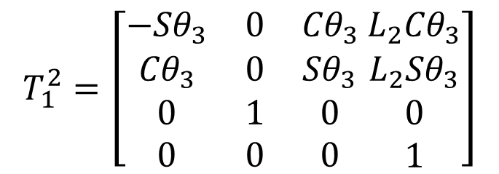
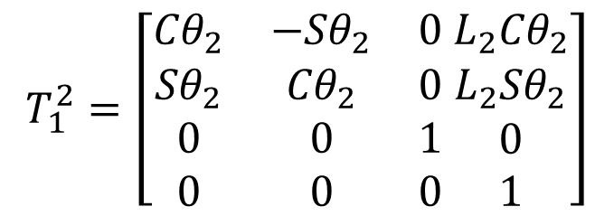

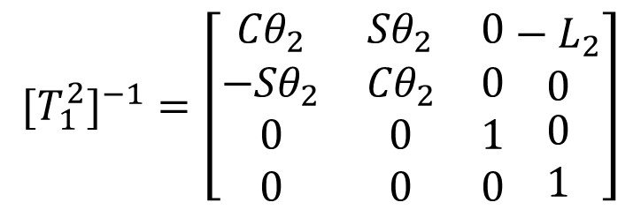
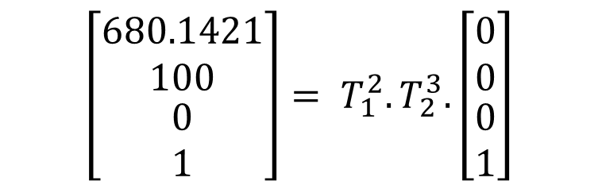
$$T_{1}^{2}=\left[\begin{matrix}{Cθ}_{2} & {−Sθ}_{2} & 0 \\ {Sθ}_{2} & {Cθ}_{2} & 0 \\ \begin{matrix}0 \\ 0\end{matrix} & \begin{matrix}0 \\ 0\end{matrix} & \begin{matrix}1 \\ 0\end{matrix}\end{matrix} \begin{matrix}{L_{2}Cθ}_{2} \\ {L_{2}Sθ}_{2} \\ \begin{matrix}0 \\ 1\end{matrix}\end{matrix}\right]$$
$$T_{1}^{2}=\left[\begin{matrix}{−Sθ}_{3} & 0 & {Cθ}_{3} \\ {Cθ}_{3} & 0 & {Sθ}_{3} \\ \begin{matrix}0 \\ 0\end{matrix} & \begin{matrix}1 \\ 0\end{matrix} & \begin{matrix}0 \\ 0\end{matrix}\end{matrix} \begin{matrix}{L_{2}Cθ}_{3} \\ {L_{2}Sθ}_{3} \\ \begin{matrix}0 \\ 1\end{matrix}\end{matrix}\right]$$
$$\left[\begin{matrix}680.1421 \\ 100 \\ \begin{aligned}0 \\ 1\end{aligned}\end{matrix}\right]= T_{1}^{2}.T_{2}^{3}.\left[\begin{matrix}0 \\ 0 \\ \begin{aligned}0 \\ 1\end{aligned}\end{matrix}\right]$$
$${{[T}_{1}^{2}]}^{−1}=\left[\begin{matrix}{Cθ}_{2} & {Sθ}_{2} & 0 \\ {−Sθ}_{2} & {Cθ}_{2} & 0 \\ \begin{matrix}0 \\ 0\end{matrix} & \begin{matrix}0 \\ 0\end{matrix} & \begin{matrix}1 \\ 0\end{matrix}\end{matrix} \begin{matrix}− L_{2} \\ 0 \\ \begin{matrix}0 \\ 1\end{matrix}\end{matrix}\right]$$
$${{{{ T}_{1}^{2}}^{−1} T}_{0}^{1}}^{−1}P=T_{2}^{3}.O$$

Slide 21
Inverse Kinematics of a 3dof Articulated Robot

Slide 22
3 dof Articulated manipulator
Problem No. 6
Develop workspace points in MATLAB for articulated manipulator whose joint angles are π, π/2 and π/2, link lengths L1 = 100mm, L₂=L₃=300 mm.

Slide 23
Link i | θ | d | α | a | Home
1 | θ1 | L1 | 90
2 | θ2 |  |  | L2
3 | θ3 |  | 90 | L3 | 90

Slide 24
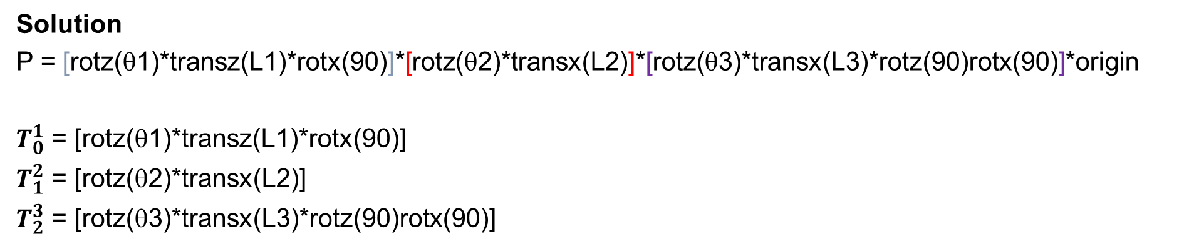
Solution
P = [rotz(θ1)*transz(L1)*rotx(90)]*[rotz(θ2)*transx(L2)]*[rotz(θ3)*transx(L3)*rotz(90)rotx(90)]*origin
$T_{0}^{1}$ = [rotz(θ1)*transz(L1)*rotx(90)]
$T_{1}^{2}$ = [rotz(θ2)*transx(L2)]
$T_{2}^{3}$ = [rotz(θ3)*transx(L3)*rotz(90)rotx(90)]
Link i | θ | d | α | a | Home
1 | θ1 | L1 | 90
2 | θ2 |  |  | L2
3 | θ3 |  | 90 | L3 | 90
$$P=\left[\begin{matrix}C_{1}\left(L_{2}C_{2}+L_{3}C_{23}\right) \\ S_{1}\left(L_{2}C_{2}+L_{3}C_{23}\right) \\ L_{3}S_{23}+L_{2}S_{2}+L_{1}\end{matrix}\right]$$

Slide 25
Inverse Kinematics of a 3 dof Articulated arm
function [theta1,theta2,theta3] = articulated_inv(Px,Py,Pz)
P = [Px;Py;Pz]
origin = [0,0,0,1]'
L1 = 200
L2 = 500
L3 = 350
theta1 = atand(P(2,1)/P(1,1))
J2 = rotz(theta1)*transz(L1)*origin
C = sqrt((P(1)-J2(1))^2 + (P(2)-J2(2))^2 + (P(3)-J2(3))^2)
theta3 = -acosd((C*C -L2*L2 - L3*L3)/(2*L2*L3))
a = C
A = pi + (theta3*pi/180)
B = asind(L3/(a/sin(A)))
e = asind((P(3)-J2(3))/C)
theta2 = (B+e)
end

Slide 26
Navigating through a sequence of points
clear all
P = [683,283,480;500,250,220;300,150,220]
L1 = 200
L2 = 500
L3 = 350
origin = [0,0,0,1]'
for i = 1:3
Px = P(i,1)
Py = P(i,2)
Pz = P(i,3)
[theta1,theta2,theta3] = articulated_inv(Px,Py,Pz)
x1 = origin
x2 = [rotz(theta1)*transz(L1)*rotx(90)]*origin
x3 = [rotz(theta1)*transz(L1)*rotx(90)]*[rotz(theta2)*transx(L2)]*origin
x4 = [rotz(theta1)*transz(L1)*rotx(90)]*[rotz(theta2)*transx(L2)]*[rotz(theta3)*transx(L3)*rotz(90)*rotx(90)]*origin
X = [x1(1),x2(1),x3(1),x4(1)]
Y = [x1(2),x2(2),x3(2),x4(2)]
Z = [x1(3),x2(3),x3(3),x4(3)]
plot3(X,Y,Z,'-rs','LineWidth',8,...
'MarkerEdgeColor','k',...
'MarkerFaceColor','g',...
'MarkerSize',15)
hold on
end

